Slide 1
LLMs for Clinical Trials
Finding the Right Clinical Trials for Patients
Semester Project: Nainika Devireddy, Amin Diab, and Jieming Chu
EN.705.651.8VL.SP24 Large Language Models: Theory and Practice
6th August 2024

Slide 2

Table of Content
Background
Aim of the Project
Introduction of the Approaches
Evaluation Methods and Results
Discussions
Conclusion
Potential Improvements and Future Considerations
References
Supplement List
References: Picture by DALL-E. OpenAI.
Notes:
EXPLAIN STRUCTURE FIRST.
The Mamba paper is very difficult to understand without understanding the underlying concepts. So in this presentation I will use a mixture of my own explanations as well as good explanations from the materials in the paper sign-up sheet. In the paper sign-up sheet there a blog post titled a visual guide to Mamba and State Space Models written by Maarten Grootendorst. I am going to borrow some of his explainations and visualizations, supplemented by some performance result screenshots from the authors presentations and papers.

Slide 3
Background
Clinical trials evaluate the efficacy and safety of new treatments, drugs, medical devices, and diagnostic tools on human health outcomes
The recruitment process is critical for the success of clinical trials, ensuring valid and applicable results on the specified target population, but faces challenges that can lead to delays, increased costs, and potential study failure.
Eligibility criteria include age, gender, disease type and category, previous treatment history, overall health status, and specific genetic markers. Designed to ensure study results are relevant and participants' safety is maximized.
NIH’s ClinicalTrials.gov is the primary resource but requires manual examination of each search result against a patient’s health record. The current process is inefficient, requiring significant time and effort to manually verify eligibility.

Slide 4
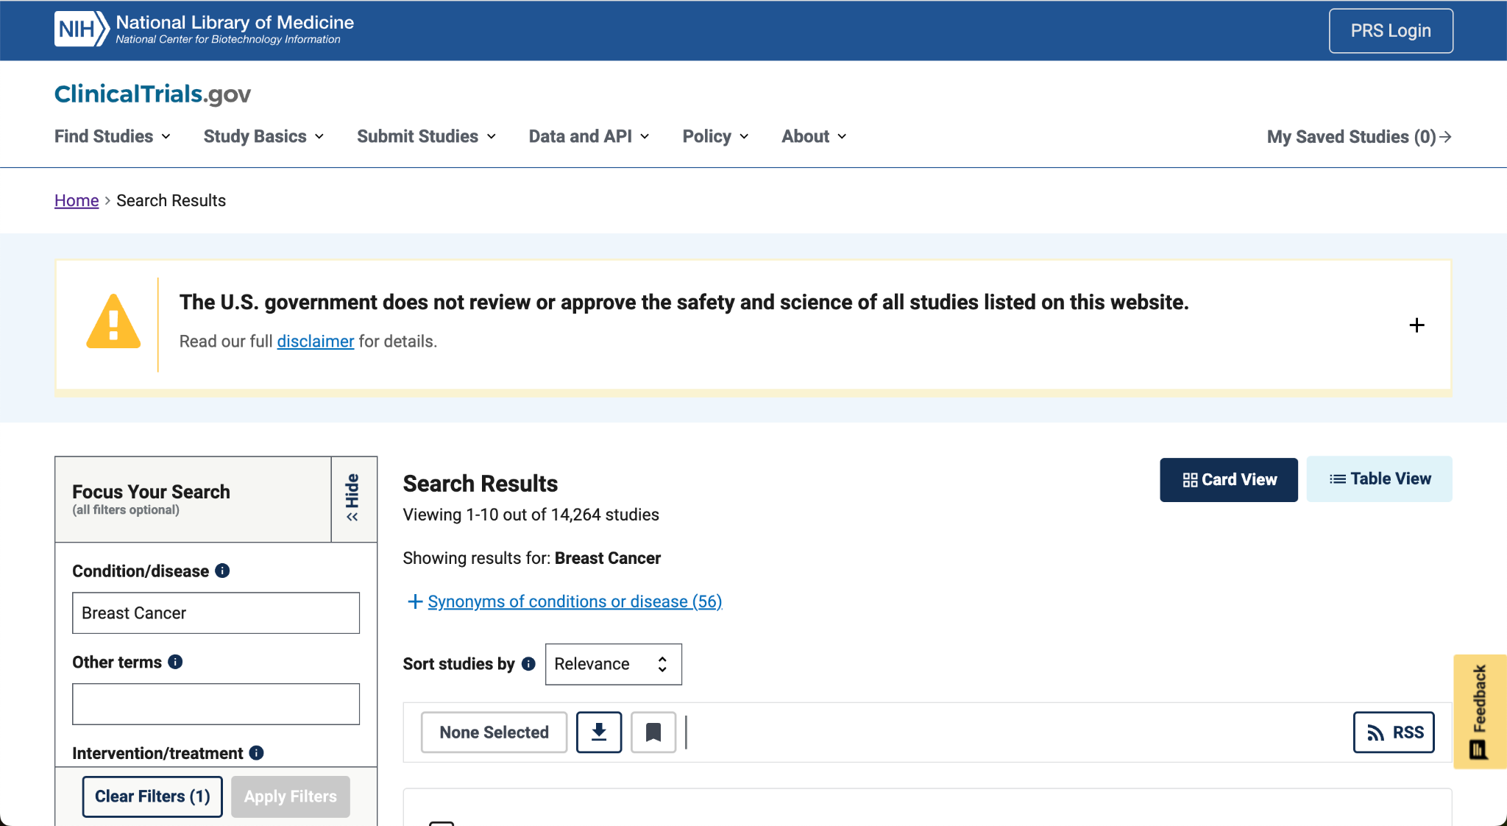
ClinicalTrials.gov Search Results

Slide 5
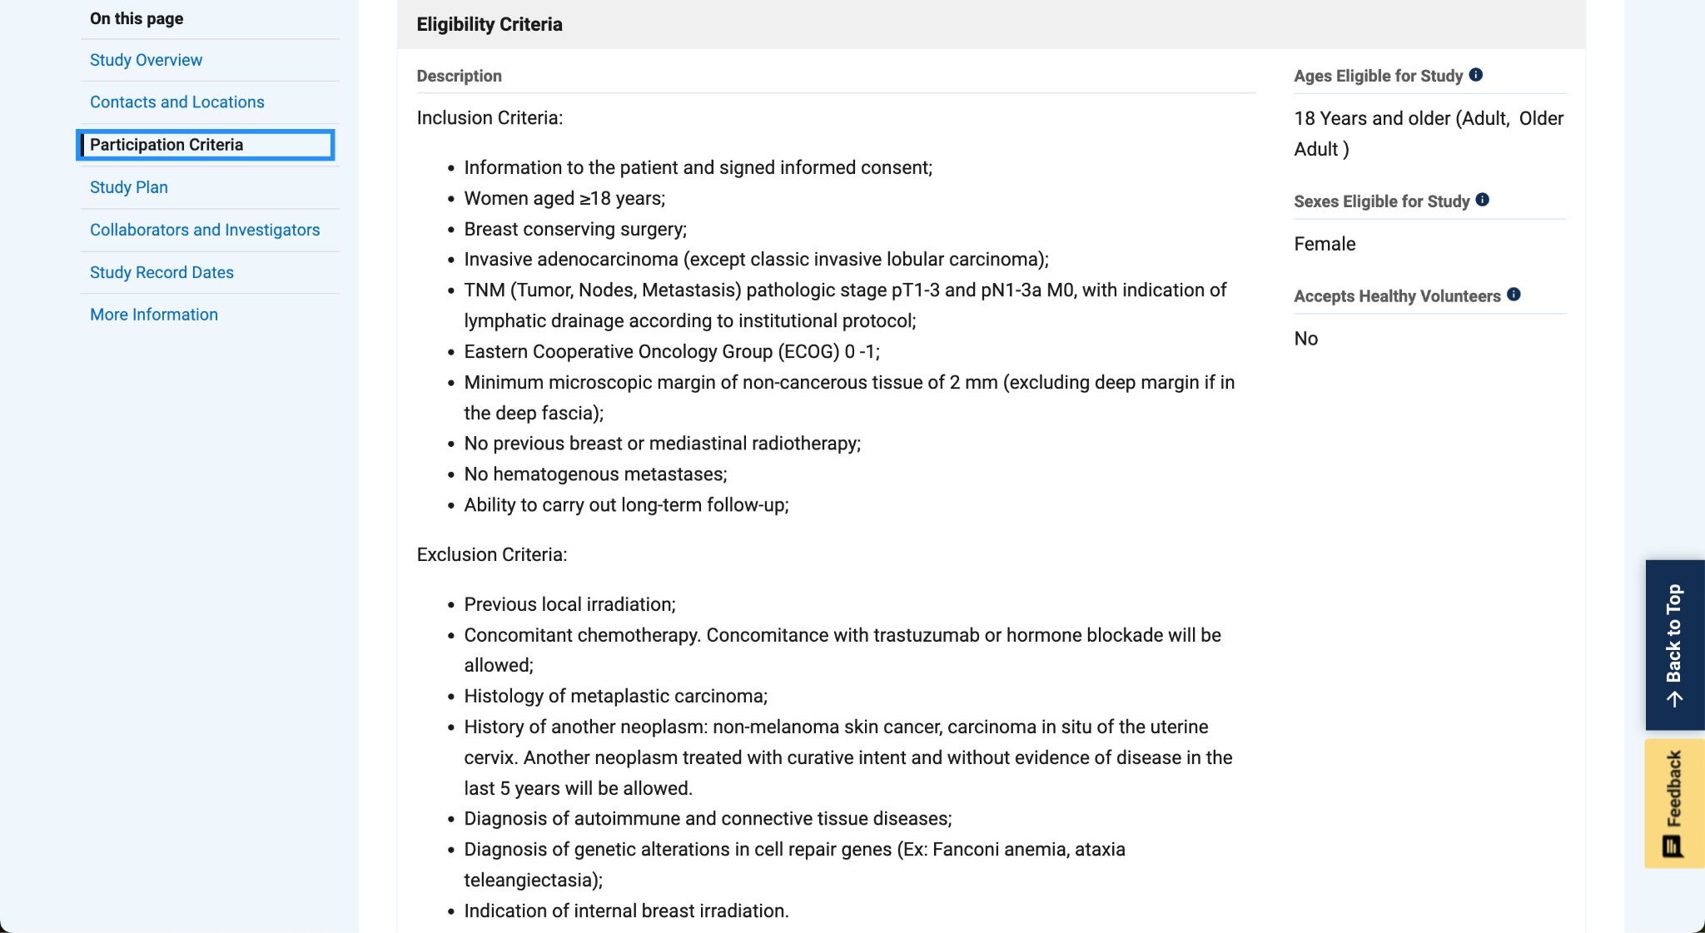
ClinicalTrials.gov Eligibility Criteria

Slide 6
Aim of the Project
Primary Goal: Evaluate different large language model (LLM) approaches to identify clinical trials for which a patient is eligible.
Comparison of Approaches: Compare the effectiveness of various query methods and prompt-engineering techniques.
Retrieval-Augmented Generation: Assess the performance of a Retrieval-Augmented Generation (RAG)-enabled LLM approach.
Outcomes: Identify key features that result in better model performance in matching patients to clinical trials

Slide 7
Data Source: ClinicalTrials.gov
Source: Clinical trial records obtained from ClinicalTrials.gov using their REST API.
Unique Identifiers: Each clinical study uniquely identified by a National Clinical Trial Identification Number (NCT Number).
Eligibility Criteria: Provided as markup text with demarcated 'Inclusion Criteria' and 'Exclusion Criteria'.
Extracted Attributes: NCT ID, Overall progress status, Start date, Conditions, Interventions, Locations, Primary completion date, Date posted and last updated, Study type, Current trial phase, and Eligibility criteria,
Focus: Only actively recruiting breast cancer clinical trials were included for thorough analysis.

Slide 8
Data Source: Synthea Synthetic Patients
Source: Patient records obtained from Synthea, an open-source software generating HIPAA-compliant synthetic patient records.
Composition:
200 lifetime/longitudinal patient records.
179 female breast cancer patients.
14 male breast cancer patients.
6 patients with assorted other cancers (lung, colorectal, prostate).
Format: Data follows Minimal Common Oncology Data Elements (mCODE) STU1 (release 1) format.
Selection: 10 synthetic patients selected using stratified sampling for model evaluation, including one male patient and one patient with colon cancer.
Pre-Processing: JSON files rearranged into patient dictionary of DataFrames for better readability.

Slide 9
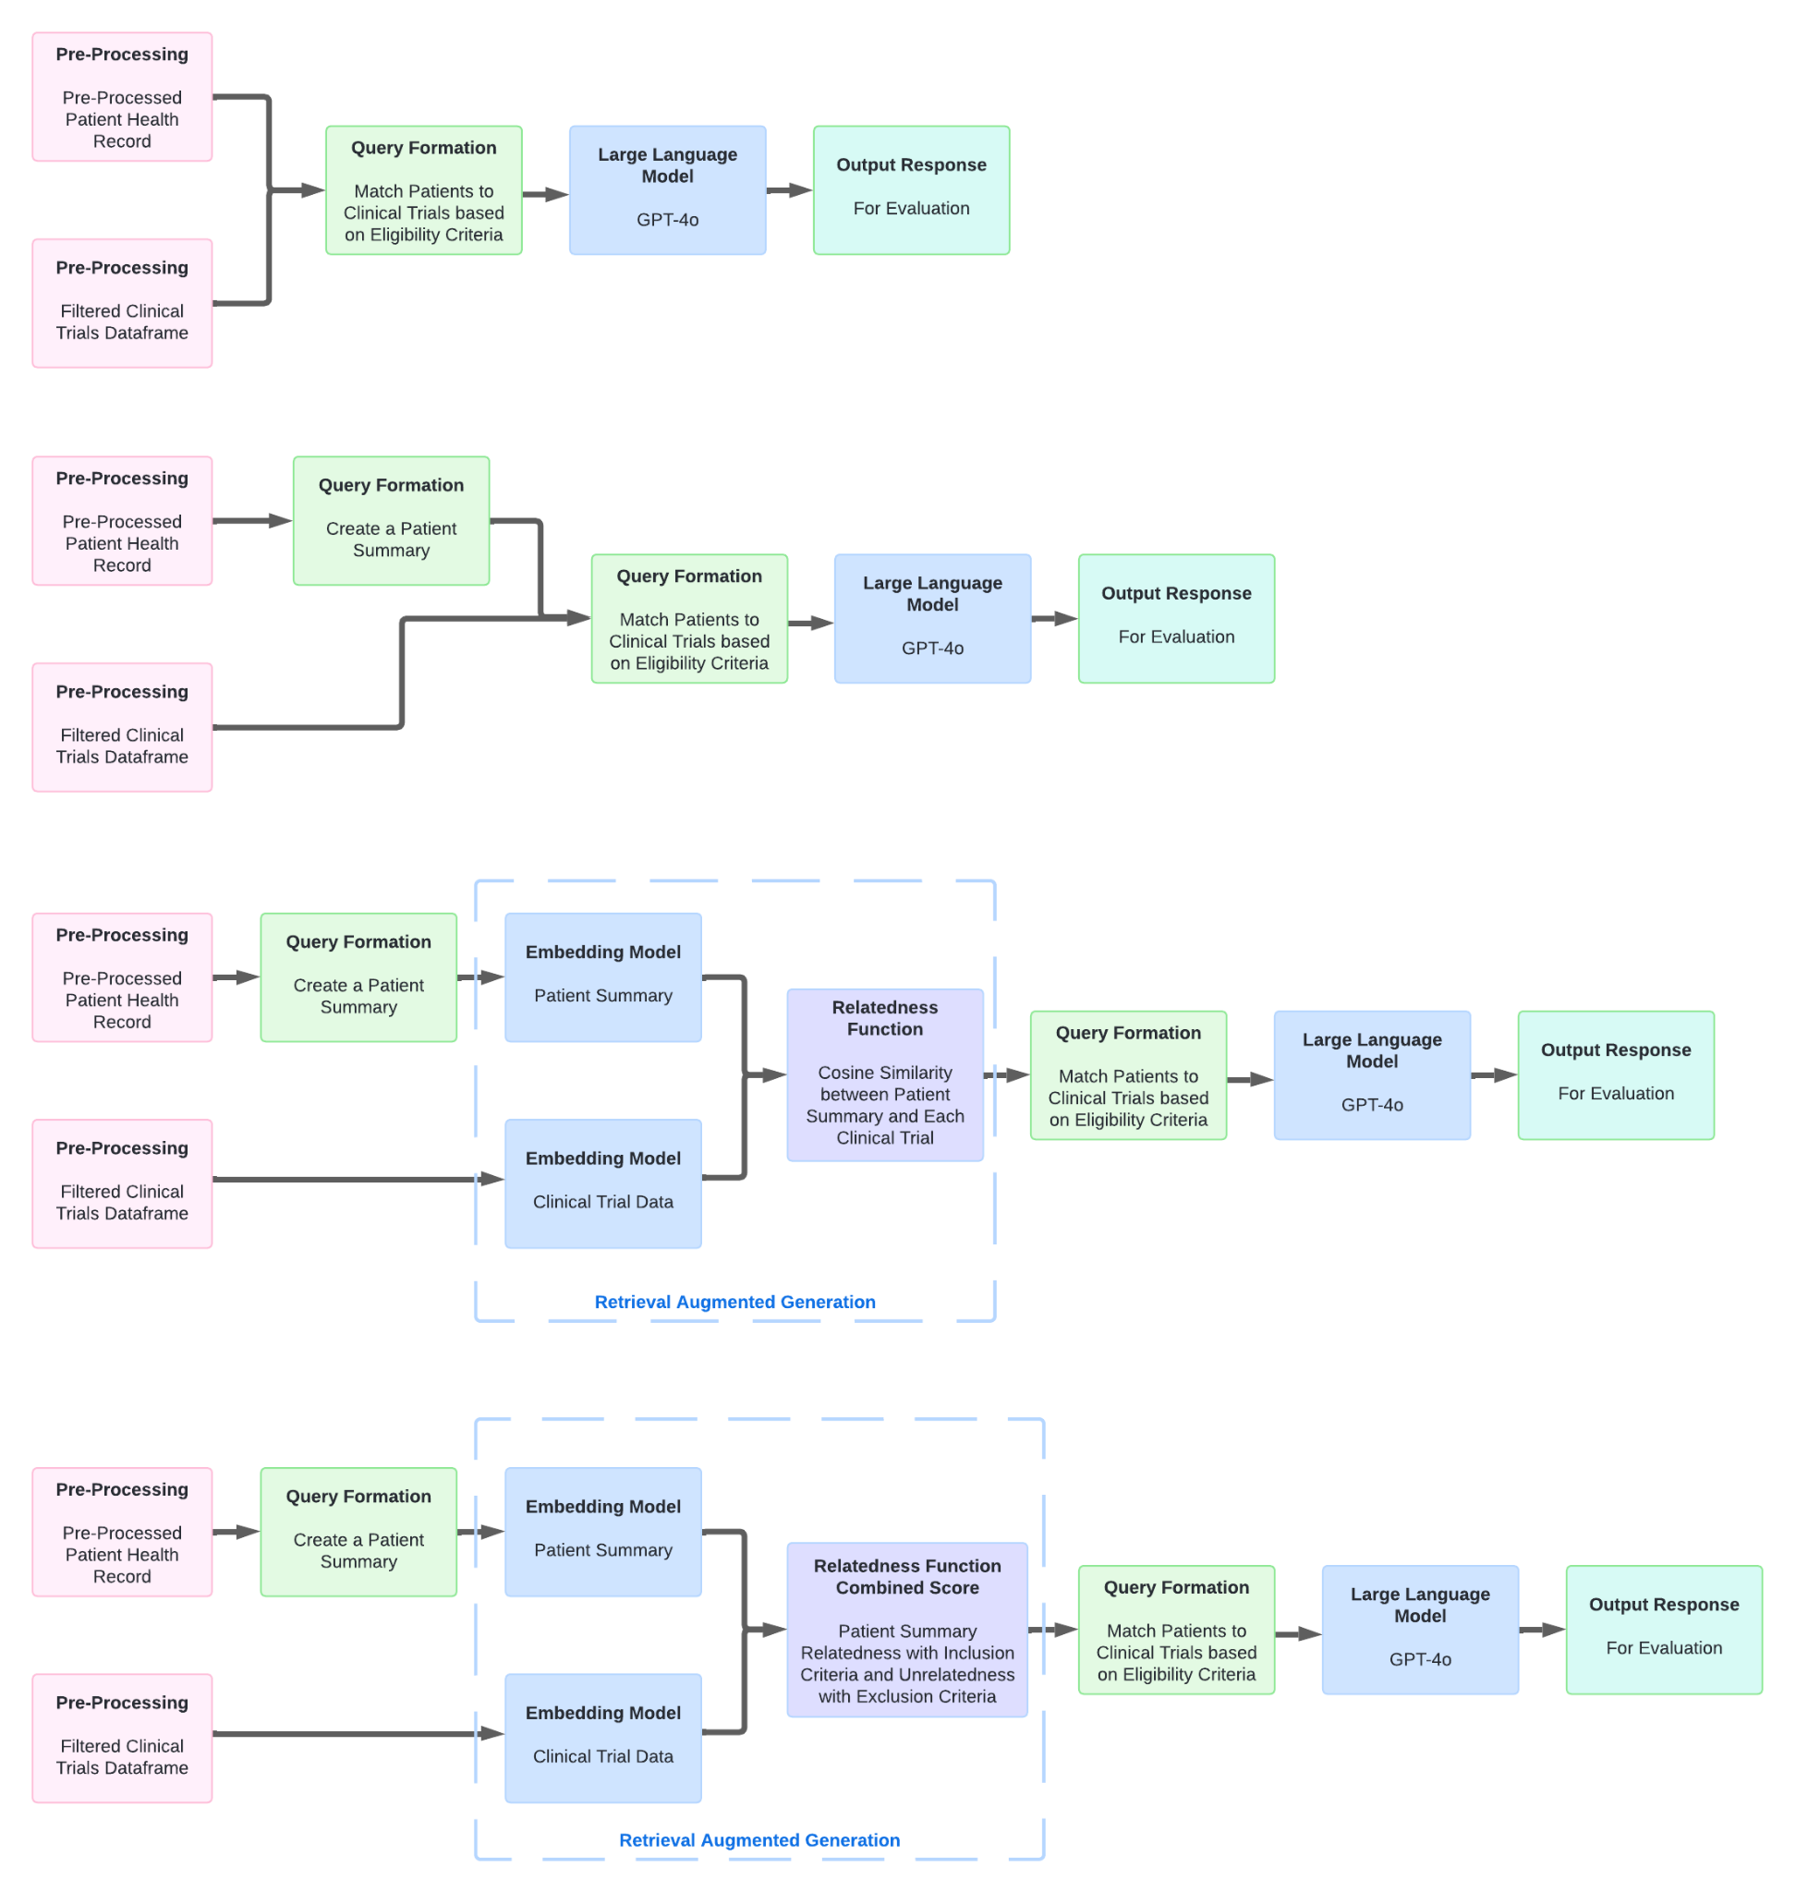
Approach 1
Incorporating Full Patient Data and Clinical Trial Data in the Query

Slide 10
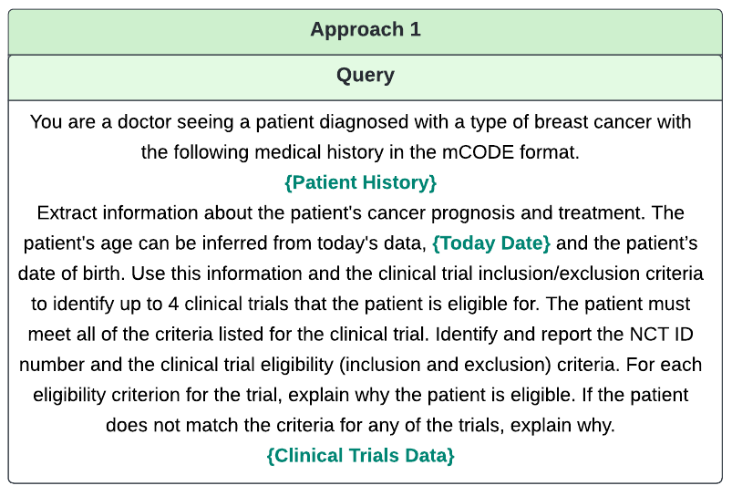
Approach 1
Incorporating Full Patient Data and Clinical Trial Data in the Query

Slide 11
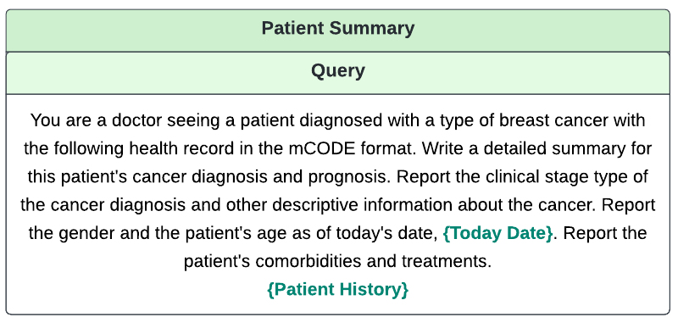
Creating a Patient Summary from the Health Record
Prompting the LLM to Summarize the Patient Health Record

Slide 12
Approach 2
Incorporating Patient Summary and Clinical Trial Data in the Query

Slide 13
Approach 3
Incorporating Patient Summary and Clinical Trial Data in a RAG-Enabled LLM Query

Slide 14
Approach 4
Incorporating Patient Summary and Clinical Trial Data in a RAG-Enabled LLM Query
with a Modified Similarity Metric

Slide 15
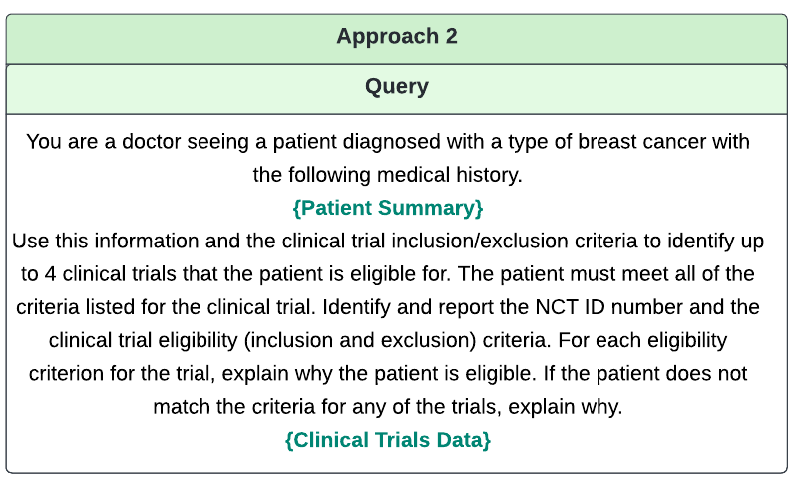
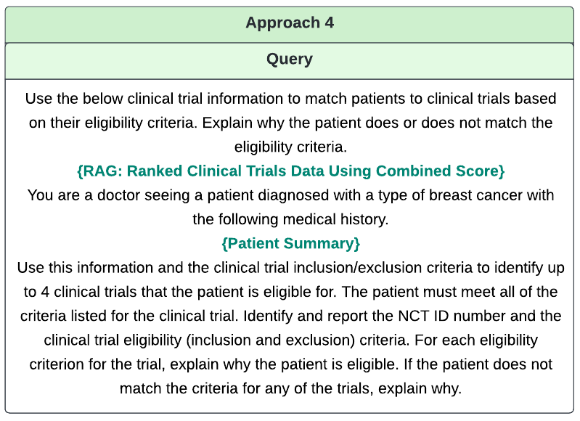
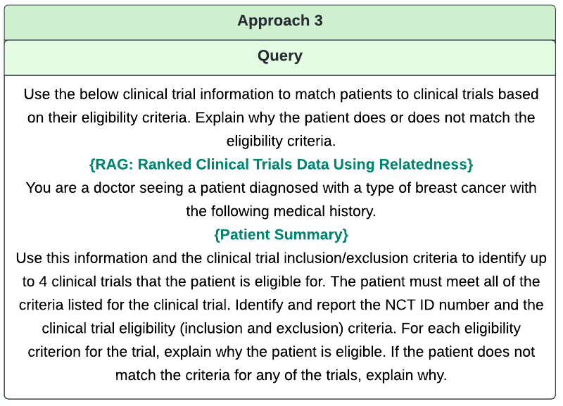
Prompt Engineering

Slide 16
Prompt Engineering

Slide 17
Quantitative LLM Evaluation
The response from the LLM for each approach was evaluated as shown below:
a) Inspect the stated clinical trials in the LLM’s response to matching a patient to clinical trials.
b) Check the accuracy in the stated clinical trials primarily along two dimensions
Whether the eligibility criteria are correct (no hallucinations), and
Whether any part of the patient history has been omitted in the model’s output
c) Show the number of times (out of 4 since there are four trials per response) that the stated information about the trial is correct. For example when assessing the LLM response in an approach, if the LLM indicated that a patient is not eligible for a trial that is listed in the response, and the stated reason for ineligibility is correct, then one point is awarded for accuracy. However, if the LLM response in a stated trial included any hallucination or if any part of the patient history was misrepresented in the model’s output, then remove one point. So by that reasoning, 4 is the highest score in the evaluation while 0 is the lowest score.

Slide 18
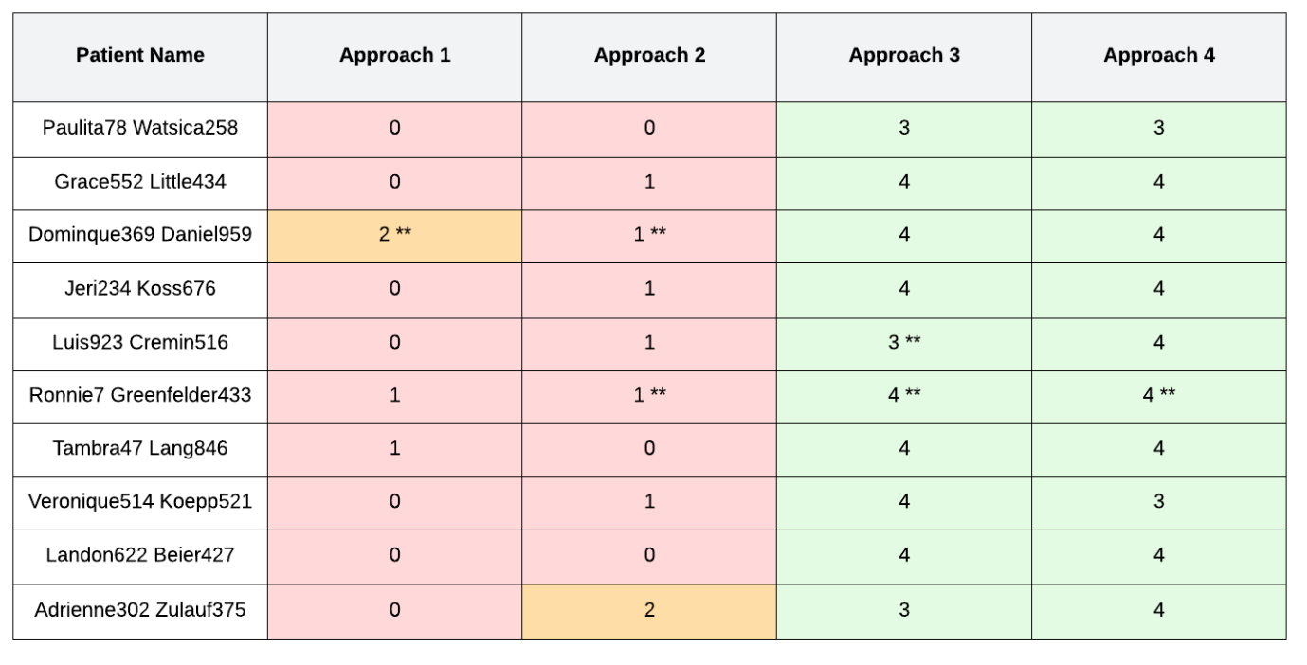
Results of Quantitative LLM Evaluation
The table below shows results of evaluation across the four aforementioned approaches.
** The model returned more than 4 candidate trials, the first 4 were tested for this evaluation.
The table shows that approaches 3 and 4 outperformed approaches 1 and 2. Red denotes that the approach exhibited a score below 50% (i.e. below 2 out of 4), orange denotes a 50% score and green denotes a score above 50%. One point worthy of note is that on rare occasions, approaches 3 and 4 demonstrated a tendency to be overly strict when deducing the patient eligibility for a trial. Further detail about the behaviour of the LLM under each approach can be found in the Supplement section.

Slide 19
Summary of Qualitative Evaluation Results
Approach 1: Overly simplified output, recall error, reasoning error, hallucinations
Approach 2: Overly simplified output, recall error, reasoning error, hallucinations
Approach 3: Detailed output, improvements in recall and reasoning
Approach 4: Detailed output, improvements in recall and reasoning

Slide 20
Example Output from Approach 1
### Clinical Trial 3: NCT05989776
- **Eligibility Criteria**: Patients over 18 and under 75 years of age with breast cancer.
- **Reason for Eligibility**:
- **Age**: The patient is 56 years old, which falls within the specified age range.
- **Diagnosis**: The patient has been diagnosed with breast cancer.
### Clinical Trial 4: NCT04506476
- **Eligibility Criteria**: Capacity for consent, diagnosed with breast cancer, and undergoing or completed treatment.
- **Reason for Eligibility**:
- **Consent**: Assuming the patient can provide consent.
- **Diagnosis and Treatment**: The patient has breast cancer and is likely undergoing treatment based on her medical history.

Slide 21
Qualitative Evaluation of Approach 1: Hallucination Error
Approach 1: Incorporating Full Patient Data and Clinical Trial Data in the Query
Synthetic Patient Name: Paulita78 Watsica258 (Walonoski, et al., 2018).
LLM Generated Trial #3: NCT05989776
LLM's Assessment: Patient eligible
Human Expert Consensus Assessment: Patient ineligible
Error: Hallucination
Error details: LLM claims patient is 56 and falls within the inclusion criteria age range of 18-75. But the actual eligibility criteria says that patients should be between the ages of 18-40.

Slide 22
Qualitative Evaluation of Approach 1: Recall Error
Approach 1: Incorporating Full Patient Data and Clinical Trial Data in the Query
Synthetic Patient Name: Paulita78 Watsica258 (Walonoski, et al., 2018).
LLM Generated Trial #4: NCT04506476
LLM's Assessment: Patient eligible
Human Expert Consensus Assessment: Patient ineligible
Error: Recall Error
Error details:Trial name is Trial Evaluating the Benefit of a Fitness Tracker Based Workout During Adjuvant Radiotherapy of Breast Cancer. LLM misses the most important inclusion criteria of "Indication for adjuvant radiotherapy of breast cancer after breast-conserving surgery or Ablatio mammae". The synthetic patient is prescribed Megavoltage radiation therapy using photons (procedure), not RT, and therefore should be excluded.

Slide 23
Example Output from Approach 2
### Trial 4: NCT05781633
**Eligibility Criteria:**
- Signed informed consent.
- Female patients with histologically confirmed breast cancer.
**Patient's Eligibility:**
- Assuming Mrs. Watsica is willing to sign informed consent, she meets the first criterion.
- She has a diagnosis of malignant neoplasm of the breast, which is histologically confirmed breast cancer, thus meeting the second criterion.

Slide 24
Qualitative Evaluation of Approach 2: Recall Error
Approach 2: Incorporating Patient Summary and Clinical Trial Data in the Query
Synthetic Patient Name: Paulita78 Watsica258 (Walonoski, et al., 2018).
LLM Generated Trial #4: NCT05781633
LLM's Assessment: Patient eligible
Human Expert Consensus Assessment: Patient ineligible
Error: Recall Error
Error details: Patient did not receive Eutideron, Etoposide, or Bevacizumab. The synthetic patient also does not have brain metastases from breast cancer.

Slide 25
Example Output from Approach 3
1. **NCT04360330**
- **Inclusion Criteria:**
(OMITTED FOR BREVITY)
- Patients with metastatic disease. (Eligible)
- ECOG 2, 3, 4. (Not specified in patient summary)
- Patients that are unable to undergo MRI. (Not specified in patient summary)
- Prior history of radiation to the chest. (Ineligible due to radiation therapy in 2020)
- History of collagenous disease. (Eligible)
- Any serious medical or psychiatric illness/condition likely to interfere or limit compliance with study requirements/treatment. (Eligible)
- Diagnosis of another primary malignancy within the last 5 years. (Eligible)
- Patients unable to consent, who are pregnant or nursing, or are prisoners. (Eligible)

Slide 26
Qualitative Evaluation of Approach 3: Better Recall and Reasoning
Approach 3: Incorporating Patient Summary and Clinical Trial Data in a RAG-Enabled LLM Query
Synthetic Patient Name: Paulita78 Watsica258 (Walonoski, et al., 2018).
LLM Generated Trial#1: NCT03147430
LLM's Assessment: Patient ineligible
Human Expert Consensus Assessment: Patient ineligible
LLM Performance Improvement: Better recall and reasoning
Improvement details: 2020 radiation therapy makes patient ineligible
Correct judgement on ineligibility of all four generated trials
Notes:
The LLM correctly and exhaustively generated the inclusion and exclusion criteria of the trial and appended its comment to the end of each criterion. In cases where information in the inclusion criteria is not specified in the patient summary, the LLM correctly stated as such. Improvement details: the LLM correctly understood from the patient record that the patient underwent radiation therapy in 2020 and that this makes the patient excluded from the trial because the exclusion criteria specifies that prior history of radiation to the chest is an exclusion criterion.

Slide 27
Example Output from Approach 4
### NCT04913064
**Inclusion Criteria:**
1. Postmenopausal women who have increased risk of breast cancer and high BMI ≥ 30 kg/m². **(Eligible)**
(OMITTED FOR BREVITY)
**Exclusion Criteria:**
1. Active malignancy within the past 5 years with the exception of non-melanoma skin cancer or carcinoma in situ of the cervix. **(Eligible)**
2. Ongoing chemotherapy, radiation therapy, or other cancer-related treatment. **(Not eligible, received radiation therapy in 2020)**
3. History of a bleeding tendency or current use of Coumadin or other anticoagulants. **(Eligible)**
(OMITTED FOR BREVITY)
13. Subjects, who in the opinion of the investigator, may not be able to comply with the safety monitoring requirements of the study. **(Eligible)**

Slide 28
Qualitative Evaluation of Approach 4: Better Recall and Reasoning
Approach 4: Incorporating Patient Summary and Clinical Trial Data in a RAG-Enabled LLM Query with a Modified Similarity Metric
Synthetic Patient Name: Paulita78 Watsica258 (Walonoski, et al., 2018).
LLM Generated Trial#1: NCT03147430
LLM's Assessment: Patient ineligible
Human Expert Consensus Assessment: Patient ineligible
LLM Performance Improvement: Better reasoning
Improvement details: detailed comment on each criterion, understood 2020 radiation therapy excluded patient
LLM made correct judgement on all 4 generated trials

Slide 29
Qualitative Evaluation of Approach 4: Inaccurate Knowledge
Approach 4: Incorporating Patient Summary and Clinical Trial Data in a RAG-Enabled LLM Query with a Modified Similarity Metric
Synthetic Patient Name: Paulita78 Watsica258 (Walonoski, et al., 2018).(See Suppl. S1)
LLM Generated Trial#1: NCT03147430
LLM's Assessment: Patient ineligible
Human Expert Consensus Assessment: Patient ineligible
LLM Performance Error : Medical Knowledge Inaccuracy
Error details: the LLM incorrectly inferred from the patient record that the patient at 56 years old is already postmenopausal and therefore does not satisfy the inclusion criterion WOCBP must agree to use adequate contraception or agree to undergo sexual abstinence.

Slide 30
Discussion
The impact of data:
Structure: Utilizing the full patient record data to match trials presents a challenging task due to the data’s structure; a nested structure that requires parsing to interpret. Prior studies used plain text for relatively simple data summaries. This project’s approach of summarizing data using LLMs is one way to mitigate this challenge.
Exhaustiveness: The responses were strongly influenced by the exhaustiveness of input patient health record data in the query. Indeed, the model in approaches 3 and 4 correctly identified that information was missing, hinting that more comprehensive data sources are likely to bear a positive influence on model responses.
Synthetic vs Real: Synthetic data is structured, yet real-world data is often complex and unstructured, posing challenges for applications. This project used synthetic data to comply with safety and ethical considerations but real-world applications may require more advanced preprocessing techniques to mitigate these challenges.

Slide 31
Discussion (Continued)
The impact of prompt engineering:
Content of the prompt: Instructing the model to provide reasons for its recommendations gave better results. Prompting for multiple trial recommendations also provided more comprehensive responses, with transparency on model reasoning, to identify areas of improvement. Furthermore, specificity of responses correlated with the specificity of the input data; the model processed key information better with the added specificity.
Structure of the prompt: Splitting prompt instructions into separate sentences, carefully ordering the prompts, and emphasizing specific information in the prompt improved the responses. Yet, maximizing the context window did not always yield better responses. A larger input increased complexity, leading to less coherent responses, hinting that context window management is needed to deliver sufficient data without overwhelming the model.

Slide 32
Conclusion
This project demonstrated the efficacy of four approaches to using LLMs to match patients with clinical trials. It was found that RAG significantly enhances accuracy when utilizing LLMs, highlighting RAG’s potential to streamline the patient recruitment process, and improve the efficiency and success rate of matching clinical trials to patients.
Significant insights were gained regarding the impact of data and prompt engineering. Model sensitivity to input data was observed to be high, indicating that improved input could enhance performance. Prompt engineering played a notable role in refining responses, underscoring the necessity for carefully crafted queries to improve performance.
While the current implementation of RAG is successful, continuous improvement in data processing, evaluation methods, and prompt engineering strategies is essential for even more consistent and accurate results. Lessons learned from this study will guide future developments, ensuring that the model remains a valuable tool in clinical research and patient recruitment.

Slide 33
Potential Improvements & Future Considerations
Comparing performance across more LLMs can help benchmark model performance and identify areas of improvement. BioGPT, can provide insights into how domain-specific training impacts performance. LLAMA could offer alternative approaches to enhance performance. These comparisons could reveal strengths and weaknesses, guiding refinements in model architecture and training.
Employing more robust evaluation methods may facilitate a more comprehensive assessment of performance by including recall, precision, and F1 scores as well as accuracy. Additionally, real-world validation with clinical experts could provide valuable feedback on model effectiveness and usability.
Example-based prompting can potentially enhance the model’s understanding of the expected output format and the data needed to improve matching patients to trials. Complex patient cases and vast medical terminology hint that many examples may be needed for this. Another approach to explore is Reinforcement Learning from Human Feedback (RLHF), to potentially improve accuracy continuously using expert human input.

Slide 34
Improvements & Future Considerations (Continued)
Integrating the ClinicalTrials API as a tool for the LLM may enhance its real-time querying capabilities, towards recommendations are more current and relevant. Indeed, real-time access to the databases would streamline patient matching, making it more efficient and reduce manual workload on healthcare providers.
Feature extraction techniques can crystallize the features most relevant to matching clinical trials, and use those features with specific patient health record data to provide the model with even more precise information. Such an approach can potentially enhance the model performance.
A scoring system can be implemented to prompt the LLM to rank the relevance of clinical trials based on how well they match the patient's profile, thereby providing a more structured and quantifiable approach to trial matching.

Slide 35
References
OpenAI et. al. (2023). GPT-4 Technical Report. https://arxiv.org/abs/2303.08774
OpenAI. (2024). Hello GPT-4o. https://openai.com/index/hello-gpt-4o/
Luo et. al. (2022). BioGPT: Generative Pre-trained Transformer for Biomedical Text Generation and Mining. https://arxiv.org/abs/2210.10341
Clinicaltrials.gov.
NIH: User Guide for Clinicaltrials.gov Website: https://clinicaltrials.gov/submit-studies/prs-help/user-guide#intro
Jin, Q., Wang, Z., Floudas, C. S., Chen, F., Gong, C., Bracken-Clarke, D., ... & Lu, Z. (2023). Matching patients to clinical trials with large language models. ArXiv.arXiv:2307.15051v4. Accessed on August 2, 2024. Available from: https://www.ncbi.nlm.nih.gov/pmc/articles/PMC10418514/
Koopman, B., & Zuccon, G. (2016, July). A test collection for matching patients to clinical trials. In Proceedings of the 39th International ACM SIGIR conference on Research and Development in Information Retrieval (pp. 669-672).
Msv, J. (2023, July 21). Tutorial: Build a Q&A bot for Academy Awards based on ChatGPT. The New Stack. https://thenewstack.io/tutorial-build-a-qa-bot-for-academy-awards-based-on-chatgpt/
Stack OverFlow, Accessed on August 4th 2024. https://stackoverflow.com/questions/78415818/how-to-get-full-results-with-clinicaltrials-gov-api-in-python
Roberts, K., Demner-Fushman, D., Voorhees, E.M., Bedrick, S. & Hersh, W.R. Overview of the TREC 2021 Clinical Trials Track. in Proceedings of the Thirtieth Text REtrieval Conference (TREC 2021) (2021).
Walonoski, J., Kramer, M., Nichols, J., Quina, A., Moesel, C., Hall, D., ... & McLachlan, S. (2018). Synthea: An approach, method, and software mechanism for generating synthetic patients and the synthetic electronic health care record. Journal of the American Medical Informatics Association, 25(3), 230-238.
Ceylan, B., & Özerdoğan, N. (2015). Factors affecting age of onset of menopause and determination of quality of life in menopause. Turkish journal of obstetrics and gynecology, 12(1), 43–49. https://doi.org/10.4274/tjod.79836
Swanner, K. D., & Richmond, L. B. (2023). A 65-Year-Old Woman With No Menopause History: A Case Report. Cureus, 15(9), e44792. https://doi.org/10.7759/cureus.44792

Slide 37
Supplement
S1.LLM Output Highlights
S2. Qualitative Evaluation of LLM Output (See Paper)
S3.Detailed Results of LLM Evaluation

Slide 38
S1. LLM Output Highlights: Approach 1, page 1
Based on the provided data, the patient is a female born on March 10, 1968. As of today's date, August 1, 2024, she is 56 years old. The patient has been diagnosed with malignant neoplasm of the breast (breast cancer), as indicated in the 'Condition' section of the mCODE data.
To find suitable clinical trials for the patient, we need to consider her age, diagnosis, and other relevant medical history. Here are four clinical trials that the patient might be eligible for, based on the inclusion criteria related to age, gender, and diagnosis:
### Clinical Trial 1: NCT03147430
- **Eligibility Criteria**: Women who receive a standard of care for breast cancer.
- **Reason for Eligibility**:
- **Gender**: The trial specifically mentions women, which matches the patient's gender.
- **Diagnosis**: The trial is for patients receiving standard care for breast cancer, which is likely applicable to this patient given her diagnosis.
### Clinical Trial 2: NCT04638725
- **Eligibility Criteria**: HER2-positive breast cancer patients.
- **Reason for Eligibility**:
- **Diagnosis**: If the patient's breast cancer is HER2-positive (this information needs to be confirmed), she would be eligible based on her diagnosis.
### Clinical Trial 3: NCT05989776
- **Eligibility Criteria**: Patients over 18 and under 75 years of age with breast cancer.
- **Reason for Eligibility**:
- **Age**: The patient is 56 years old, which falls within the specified age range.
- **Diagnosis**: The patient has been diagnosed with breast cancer.
### Clinical Trial 4: NCT04506476
- **Eligibility Criteria**: Capacity for consent, diagnosed with breast cancer, and undergoing or completed treatment.
- **Reason for Eligibility**:
- **Consent**: Assuming the patient can provide consent.
- **Diagnosis and Treatment**: The patient has breast cancer and is likely undergoing treatment based on her medical history.
For each of these trials, further details from the patient's medical records (such as specific type of breast cancer, current treatment details, and overall health status) would be necessary to confirm eligibility. Additionally, logistical considerations such as the patient's ability to travel to the trial locations and her interest in participating should also be taken into account.
If more specific information about the patient's type of breast cancer (e.g., HER2 status) or other health conditions is available, it would help refine the selection of appropriate clinical trials.

Slide 39
Illustrative results from approach 2, page 1
Based on the provided clinical trial data and the patient's medical history, let's evaluate Mrs. Watsica's eligibility for some of the listed clinical trials. We will focus on trials related to breast cancer, as that is her primary diagnosis.
### Trial 1: NCT03147430
**Eligibility Criteria:**
- Women who receive a standard of care for breast cancer.
**Patient's Eligibility:**
- Mrs. Watsica has been diagnosed with breast cancer and has received standard care including radiation therapy. Therefore, she meets this criterion.
### Trial 2: NCT04638725 (SIGHER)
**Eligibility Criteria:**
- HER2-positive breast cancer patients.
**Patient's Eligibility:**
- The patient's medical history does not specify that her breast cancer is HER2-positive. Without this information, we cannot confirm her eligibility for this trial.
### Trial 3: NCT05989776 (EVAPREF)
**Eligibility Criteria:**
- Patients over 18 and under 75 years of age.
- Diagnosed with breast cancer.
**Patient's Eligibility:**
- Mrs. Watsica is 56 years old, which fits within the age range specified.
- She has been diagnosed with breast cancer, meeting the second criterion.

Slide 40
Illustrative results from approach 2, page 2
### Trial 4: NCT05781633
**Eligibility Criteria:**
- Signed informed consent.
- Female patients with histologically confirmed breast cancer.
**Patient's Eligibility:**
- Assuming Mrs. Watsica is willing to sign informed consent, she meets the first criterion.
- She has a diagnosis of malignant neoplasm of the breast, which is histologically confirmed breast cancer, thus meeting the second criterion.
### Conclusion:
Mrs. Watsica is eligible for the following clinical trials based on the information provided:
- **NCT03147430**: She meets the criterion of receiving standard care for breast cancer.
- **NCT05989776 (EVAPREF)**: She fits the age range and has a diagnosis of breast cancer.
- **NCT05781633**: She can provide informed consent and has histologically confirmed breast cancer.
She does not appear eligible for NCT04638725 (SIGHER) as there is no information about her breast cancer being HER2-positive. Further testing would be required to determine HER2 status if considering this trial.

Slide 41
Illustrative results from approach 3, page 1
Based on the provided patient summary and the clinical trial eligibility criteria, Mrs. Paulita78 Watsica258 does not match the criteria for any of the clinical trials listed. Here is a detailed explanation of why she does not meet the eligibility criteria for each trial:
1. **NCT04360330**
- **Inclusion Criteria:**
- Female, ≥ 50 years of age. (Eligible)
- Oncotype or MammaPrint diagnosis results are required prior to the start of treatment. (Not specified in patient summary)
- Histologically confirmed invasive breast cancer. (Eligible)
- Clinical stage T1N0M0. (Eligible)
- Receptor status: ER/PR positive and HER2 negative. (Not specified in patient summary)
- Unifocal breast cancer. (Not specified in patient summary)
- ECOG 0, 1. (Not specified in patient summary)
- Ability to undergo MRI. (Not specified in patient summary)
- WOCBP must agree to use adequate contraception or agree to undergo sexual abstinence. (Not applicable as she is post-menopausal)
- Ability to understand the investigational nature, potential risks and benefits of the research study and willingness to sign the written informed consent and HIPAA document(s). (Eligible)
- **Exclusion Criteria:**
- Patients without histologically confirmed invasive breast cancer. (Eligible)
- Patients without Oncotype or MammaPrint diagnosis results at the start of treatment. (Not specified in patient summary)
- Patients with metastatic disease. (Eligible)
- ECOG 2, 3, 4. (Not specified in patient summary)
- Patients that are unable to undergo MRI. (Not specified in patient summary)
- Prior history of radiation to the chest. (Ineligible due to radiation therapy in 2020)
- History of collagenous disease. (Eligible)
- Any serious medical or psychiatric illness/condition likely to interfere or limit compliance with study requirements/treatment. (Eligible)
- Diagnosis of another primary malignancy within the last 5 years. (Eligible)
- Patients unable to consent, who are pregnant or nursing, or are prisoners. (Eligible)

Slide 42
Illustrative results from approach 3, page 2
2. **NCT04965909**
- **Inclusion Criteria:**
- Woman aged between 18 - 65 years. (Eligible)
- Diagnosis of stage 0 - III breast cancer. (Eligible)
- Primary treatment completed at least 3 months ago. (Eligible)
- Pain related to primary treatment in the last 6 months. (Not specified in patient summary)
- Access to Internet and an electronic device. (Not specified in patient summary)
- Ability to communicate fluently in Spanish. (Ineligible as primary language is English)
- Approval of participation in the study by the coordinator of the health team. (Not specified in patient summary)
- **Exclusion Criteria:**
- Another previous type of cancer or breast cancer recurrence in a period of less than 1 year. (Eligible)
- Medical diagnosis of a neurological, autoimmune or cardiovascular disease. (Eligible)
- Pathology associated with a contraindication to physical exercise. (Eligible)
- Diagnosis of serious psychiatric or neurologic disorders. (Eligible)

Slide 43
Illustrative results from approach 3, page 3
3. **NCT05033925**
- **Inclusion Criteria:**
- Female, at least 18 years old. (Eligible)
- Welfare scale 0, 1, and 2 (ECOG - WHO). (Not specified in patient summary)
- Patients with stage IV breast cancer. (Ineligible as patient has stage 1A)
- Patients who are willing to participate in the test and sign an informed consent. (Eligible)
- Patients who undergo breast cancer chemotherapy with luminal B sub-type or triple negative with anthracycline base. (Not specified in patient summary)
- Patients who are willing and able to fill out a questionnaire. (Eligible)
- Patients who are willing and able to comply with the test protocols during the test. (Eligible)
- **Exclusion Criteria:**
- Unable to meet the test protocol. (Eligible)
- Patients with liver and kidney disorders. (Eligible)
- Patients with other diseases/disorders that are meaningful according to the investigators. (Eligible)
- Patients with cancer that has metastasized to the brain. (Eligible)
- Pregnant women and breastfeeding mothers. (Eligible)
- Patients with the ejection fraction smaller-than or equal to 55%. (Not specified in patient summary)

Slide 44
Illustrative results from approach 3, page 4
4. **NCT05891561**
- **Inclusion Criteria:**
- Histologically diagnosed unilateral primary invasive breast cancer patient with pT1, pN0, and M0 disease. (Eligible)
- HER2-positive. (Not specified in patient summary)
- Complete clinical pathological information. (Not specified in patient summary)
- ECOG 0-1. (Not specified in patient summary)
- Currently not pregnant or breast-feeding. (Eligible)
- Fine organ function. (Not specified in patient summary)
- Have good compliance with planned treatment, understand the study process and sign a written informed consent. (Eligible)
- **Exclusion Criteria:**
- Bilateral or metastatic breast cancer. (Eligible)
- Receiving neoadjuvant treatment. (Not specified in patient summary)
- Other malignancies within 5 years. (Eligible)
- Severe systemic infections or other serious illnesses. (Eligible)
- HIV infection, active hepatitis B or C infection. (Eligible)
- Known allergy to or intolerance to a therapeutic drug or its excipients. (Eligible)
- Prior history of chemotherapy, endocrine therapy, biotherapy, or radiation therapy for any reason. (Ineligible due to prior radiation therapy)
- Enrollment of another investigational study within 4 weeks prior to initial administration of the investigational treatment. (Not specified in patient summary)
- Receiving live vaccine within 30 days prior to initial administration of the investigational treatment. (Not specified in patient summary)
- History of mental illness or drug abuse that may affect compliance with the trial requirements. (Eligible)
- The researchers determine that the patients were not suitable for the study. (Eligible)
Given the detailed criteria and the patient's medical history, Mrs. Watsica does not fully meet the eligibility requirements for any of the clinical trials listed. The primary reasons include prior radiation therapy, language requirements, and specific diagnostic or treatment history not aligning with the trial criteria.

Slide 45
Illustrative results from approach 4, page 1
Based on the provided patient summary and the clinical trial eligibility criteria, Mrs. Paulita78 Watsica258 does not match the criteria for any of the clinical trials listed. Here is a detailed explanation of why she does not meet the eligibility criteria for each trial:
### NCT04360330
**Inclusion Criteria:**
1. Female, ≥ 50 years of age. **(Eligible)**
2. Oncotype or MammaPrint diagnosis results are required prior to the start of treatment. **(Not specified in patient summary)**
3. Histologically confirmed invasive breast cancer. **(Eligible)**
4. Clinical stage T1N0M0. **(Eligible)**
5. Receptor status: ER/PR positive and HER2 negative. **(Not specified in patient summary)**
6. Unifocal breast cancer. **(Not specified in patient summary)**
7. ECOG 0, 1. **(Not specified in patient summary)**
8. Ability to undergo MRI. **(Not specified in patient summary)**
9. WOCBP must agree to use adequate contraception or agree to undergo sexual abstinence. **(Not applicable as she is postmenopausal)**
10. Ability to understand the investigational nature, potential risks and benefits of the research study and willingness to sign the written informed consent and HIPAA document(s). **(Eligible)**
**Exclusion Criteria:**
1. Patients without histologically confirmed invasive breast cancer. **(Eligible)**
2. Patients without Oncotype or MammaPrint diagnosis results at the start of treatment. **(Not specified in patient summary)**
3. Patients with metastatic disease. **(Eligible)**
4. ECOG 2, 3, 4. **(Not specified in patient summary)**
5. Patients that are unable to undergo MRI. **(Not specified in patient summary)**
6. Prior history of radiation to the chest. **(Not eligible due to radiation therapy in 2020)**
7. History of collagenous disease. **(Eligible)**
8. Any serious medical or psychiatric illness/condition likely to interfere or limit compliance with study requirements/treatment. **(Eligible)**
9. Diagnosis of another primary malignancy within the last 5 years. **(Eligible)**
10. Patients unable to consent, who are pregnant or nursing, or are prisoners. **(Eligible)**

Slide 46
Illustrative results from approach 4, page 2
### NCT05889390
**Inclusion Criteria:**
1. At least 18 years of age. **(Eligible)**
2. Female patient. **(Eligible)**
3. Life expectancy ≥ 6 months. **(Eligible)**
4. De novo histological/cytological diagnosis of HER2-negative breast tumor involving one breast. **(Not specified in patient summary)**
5. Diagnosis of breast tumor ≤ 40 days. **(Not eligible, diagnosed in 2020)**
6. Locally advanced stage disease (stage II and III) requiring neoadjuvant treatment. **(Not eligible, Stage 1A)**
7. ECOG status: 0-2. **(Not specified in patient summary)**
8. Suitable for and designated by the investigator for neoadjuvant therapy. **(Not specified in patient summary)**
9. Willingness to participate in the trial and signed the informed consent form for the protocol. **(Eligible)**
**Exclusion Criteria:**
1. Patient is ≤ 18 years of age. **(Eligible)**
2. Tumor of both breasts. **(Eligible)**
3. Diagnosis of breast tumor > 40 days. **(Not eligible, diagnosed in 2020)**
4. HER2 positive breast tumor. **(Not specified in patient summary)**
5. Has already received some anticancer therapy. **(Not eligible, received radiation therapy)**
6. Any previous cancer requiring anti-tumor treatment within 5 years prior to selection. **(Eligible)**
7. Co-existing serious diseases. **(Eligible)**

Slide 47
Illustrative results from approach 4, page 3
### NCT04481932
**Inclusion Criteria:**
1. Female between 18 and 70 years old. **(Eligible)**
2. Histologically confirmed as invasive breast cancer. **(Eligible)**
3. ECOG PS 0-1. **(Not specified in patient summary)**
4. The expected survival time is not less than 12 weeks. **(Eligible)**
5. Standard immunohistochemical HER2-positive breast cancer patients. **(Not specified in patient summary)**
6. The status of hormone receptors (ER and PR) can be known. **(Not specified in patient summary)**
7. Clinical examination or imaging examination of primary lesion >2cm. **(Not specified in patient summary)**
8. Patients who are operable and have not received any previous anti-tumor therapy. **(Not eligible, received radiation therapy)**
9. Echocardiography indicated left ventricular ejection fraction (LVEF)≥55%. **(Not specified in patient summary)**
10. Adequate organ and bone marrow function. **(Not specified in patient summary)**
11. I have agreed and signed the informed consent. **(Eligible)**
**Exclusion Criteria:**
1. Have received any previous anti-tumor treatment for primary invasive breast cancer. **(Not eligible, received radiation therapy)**
2. Previous (<10 years) or other malignant tumors. **(Eligible)**
3. Metastatic breast cancer (M1), bilateral or ipsilateral multifocal breast cancer. **(Eligible)**
4. Uncontrolled hypertension, systolic blood pressure > 150 MMHG and/or diastolic blood pressure > 100 MMHG. **(Not specified in patient summary)**
5. Receive other anti-tumor treatments within 4 weeks before enrollment. **(Eligible)**
6. Inability to swallow, intestinal obstruction or other factors affecting the use and absorption of medication. **(Eligible)**
7. Persons with allergic constitution or known history of allergy to the drug components of the program. **(Eligible)**
8. The patient has a severe concomitant disease or other conditions that the researcher considers inappropriate for the patient to participate in the study. **(Eligible)**
9. Non-surgically sterilized female patients of childbearing age must have negative serum or urine HCG tests within 14 days prior to study inclusion. **(Not applicable as she is postmenopausal)**
10. Other circumstances deemed inappropriate for inclusion by the researcher. **(Eligible)**

Slide 48
Illustrative results from approach 4, page 4
### NCT04913064
**Inclusion Criteria:**
1. Postmenopausal women who have increased risk of breast cancer and high BMI ≥ 30 kg/m². **(Eligible)**
2. The study population will consist of women with a relative risk of developing breast cancer that is at least > 2 x that of the general population for their age group based on any of the following: **(Not specified in patient summary)**
3. Body mass index (BMI) ≥ 30 (Asian BMI ≥ 25 kg/m²). **(Eligible)**
4. Postmenopausal, defined as continuous absence of menstruation for 12+ months. **(Eligible)**
5. Bilateral mammogram within the 12 months prior to study enrollment that is read as not suspicious for breast cancer. **(Not specified in patient summary)**
6. Serum creatinine of 1.5 X upper limit of institutional norm or less. **(Not specified in patient summary)**
7. Total bilirubin of 1.5 X upper limit of institutional norm or less. **(Not specified in patient summary)**
8. ALT and AST of less than 2 X upper limit of institutional norm or less. **(Not specified in patient summary)**
9. Hemoglobin of 9.0 gm/dL or more. **(Not specified in patient summary)**
10. Platelets of 100,000/mm³ or more. **(Not specified in patient summary)**
11. Total white blood cell (WBC) of 3500/mm³. **(Not specified in patient summary)**
12. Absolute neutrophil count (ANC) of 1500/mm³ or more. **(Not specified in patient summary)**
13. Must be willing to have about 40-50 ml of blood drawn at 0 and 3 months. **(Eligible)**
14. Must be able to swallow pills. **(Eligible)**
15. This study will assess WBM powder in postmenopausal women of 21 years of age or older. **(Eligible)**
16. Participants will have ECOG performance status 0 or 1. **(Not specified in patient summary)**
17. The effects of WBM on the developing fetus are unknown. Pregnant and women with childbearing potential are not eligible to participate in this study of postmenopausal women at high risk of breast cancer. **(Eligible)**
18. All subjects must have the ability to understand and the willingness to sign a written informed consent. **(Eligible)**
19. Prior therapies, including chemoprevention or adjuvant therapies, must have been completed for 6 or more months prior to study entry. **(Not eligible, received radiation therapy in 2020)**
**Exclusion Criteria:**
1. Active malignancy within the past 5 years with the exception of non-melanoma skin cancer or carcinoma in situ of the cervix. **(Eligible)**
2. Ongoing chemotherapy, radiation therapy, or other cancer-related treatment. **(Not eligible, received radiation therapy in 2020)**
3. History of a bleeding tendency or current use of Coumadin or other anticoagulants. **(Eligible)**
4. Concurrent use of hormone-modifying medications including systemic hormone replacement therapy. **(Not specified in patient summary)**
5. Concurrent use of immunosuppressant medications. **(Eligible)**
6. Uncontrolled intercurrent illness. **(Eligible)**
7. Chronic use of any herbal or dietary supplement containing mushrooms within the 3 months prior to entry on the study. **(Not specified in patient summary)**
8. Treatment with other investigational agents. **(Eligible)**
9. Premenopausal status. **(Eligible)**
10. Known sensitivity or allergic reactions attributed to compounds of similar chemical or biologic composition to WBM. **(Eligible)**
11. Subjects on a standing regimen of full dose aspirin (≥ 325 mg/day), NSAIDs or NSAID-containing products. **(Not specified in patient summary)**
12. Any other condition that would, in the Investigator's judgment, contraindicate the patient's participation in the clinical study due to safety concerns with clinical study procedures. **(Eligible)**
13. Subjects, who in the opinion of the investigator, may not be able to comply with the safety monitoring requirements of the study. **(Eligible)**
### Summary
Mrs. Watsica does not meet the eligibility criteria for any of the clinical trials due to various reasons such as prior radiation therapy, lack of specific diagnostic results (e.g., Oncotype or MammaPrint), and the timing of her diagnosis. Therefore, she is not eligible for any of the listed clinical trials.

Slide 49

S3: Detailed Results of LLM Evaluation
The table below shows results of evaluation across the four aforementioned approaches.
** The model returned more than 4 candidate trials, the first 4 were tested for this evaluation.
The table provides additional context regarding the nature of the errors encountered when using the LLM with the 4 approaches. Worthy of note is that on rare occasions approaches 3 and 4 showed a type of error whereby the model displayed the correct age inclusion criteria and correct age of the patient yet did not correctly determine if the patient is eligible; e.g. a case when the model correctly states that the age eligibility of a trial ranges from 18 to 70 and that the patient age is 65 old yet the model also states that the patient’s age is not suitable for the trial. Errors of such nature are rare and are includicated as “age error”.

